Slide 1
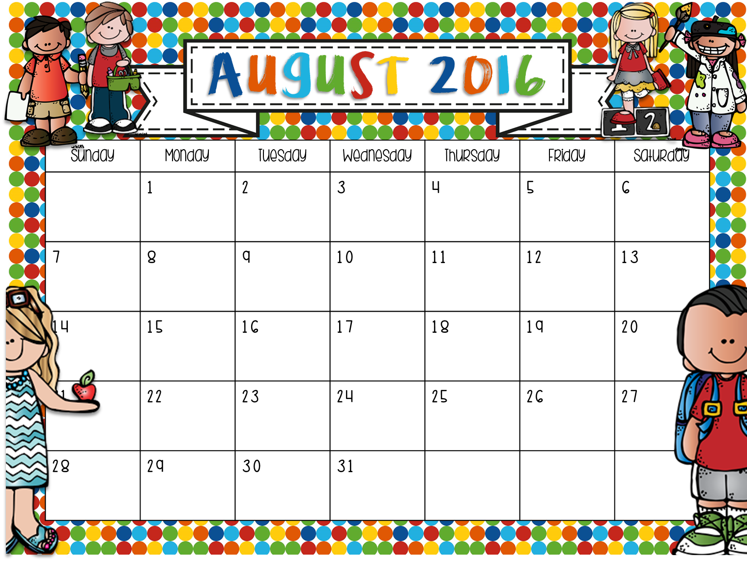
 | Tiffany—WD LaDonna- SS JoDee -- TA | Tiffany—NS LaDonna- LR JoDee -- WD | Tiffany—MV LaDonna- NS JoDee -- CH | Tiffany—CH a.m./SS p.m. LaDonna- FA JoDee -- MV | Tiffany—CO a.m./FA p.m. LaDonna- CO JoDee - CO
 | Tiffany—WD LaDonna- SS JoDee -- TA | Tiffany—NS LaDonna- LR JoDee -- WD | Tiffany—MV LaDonna- NS JoDee -- CH | Tiffany—CH a.m./SS p.m. LaDonna- FA JoDee -- MV | Tiffany—CO a.m./FA p.m. LaDonna-CO JoDee -- CO
 | Tiffany—WD LaDonna- SS JoDee -- TA | Tiffany-NS LaDonna- LR JoDee -- WD | Tiffany—MV LaDonna- NS JoDee -- CH | Tiffany—CH a.m./SS p.m. LaDonna- FA JoDee -- MV | Tiffany—CO a.m./FA p.m. LaDonna- CO JoDee -- CO
 | Tiffany—WD LaDonna- SS JoDee -- TA | Tiffany—NS LaDonna- LR JoDee -- WD | Tiffany—MV LaDonna- NS JoDee -- CH

Slide 2
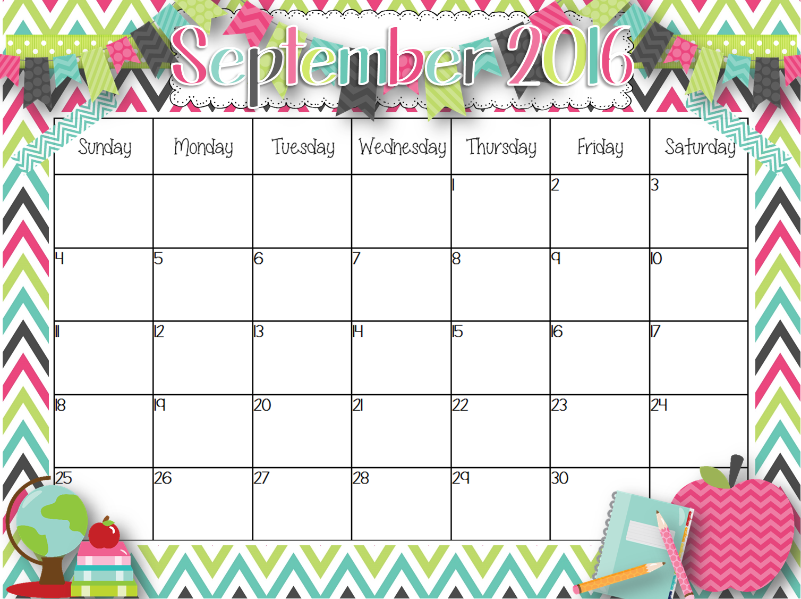
 |  |  |  | Tiffany—CH a.m./SS p.m. LaDonna- FA JoDee -- MV | Tiffany—CO a.m./FA p.m. LaDonna- CO JoDee -- CO
 | Labor Day | Tiffany—NS LaDonna- LR JoDee -- WD | Tiffany—MV LaDonna- NS JoDee -- CH
 | Tiffany—WD LaDonna- SS JoDee -- TA | Tiffany—NS LaDonna- LR JoDee -- WD | Tiffany—MV LaDonna- NS JoDee -- CH
 | Tiffany—WD LaDonna- SS JoDee -- TA | Tiffany—NS LaDonna- LR JoDee -- WD | Tiffany—MV LaDonna- NS JoDee -- CH | East TN Lit. Conference
Tiffany – CH a.m./SS p.m.
LaDonna – FA
JoDee -- MV
Tiffany – CO a.m./FA p.m.
LaDonna – CO
JoDee -- CO
Tiffany – WD
LaDonna – SS
JoDee -- TA
Tiffany – NS
LaDonna – LR
JoDee -- WD
Tiffany – MV
LaDonna – NS
JoDee -- CH
Tiffany – CH a.m./SS p.m.
LaDonna – FA
JoDee -- MV
Tiffany – CO a.m./FA p.m.
LaDonna – CO
JoDee -- CO
Tiffany – CH a.m./SS p.m.
LaDonna – FA
JoDee -- MV
Tiffany – CO a.m./FA p.m.
LaDonna – CO
JoDee -- CO
Tiffany – CO a.m./FA p.m.
LaDonna – CO
JoDee -- CO
Teaching Kids 1st

