Slide 1
Writing
Third and Fourth Grades
July 19, 2016
LaDonna S. Boone
JoDee Dotson
Tiffany Hogan

Slide 2
Welcome Teachers!
Please make sure you:
Sit with your grade level (3rd ← 4th →).
2. Make a name tent.
Please share:
Your name
Your school
Your grade level
Your subject area(s)

Slide 3
The Goals of Today’s Session
Support collaborative learning focused on increasing student achievement in Johnson City
How Will We Achieve that Goal?
Opportunities for discussion and collaboration
Direct applications to our classroom and schools
Focus on student work

Slide 4
Session Guiding Principles
All students are capable of achieving at a high level
Students rise to the level of expectation when challenged and supported appropriately
Students learn best when they are authentically engaged in their own learning
We must continuously improve our effectiveness as teachers in order to improve student success
We must make every minute with our students count with purposeful work and effective instruction

Slide 5
Our Journey Over the Past Few Years
2014-15 Teaching informative and opinion writing through the Self-Regulated Strategy Development framework
2015-16 Creating culminating writing tasks and text-dependent questions for our shared reading texts
2016-17 Embedding language into reading, exploring narrative writing, analyzing writing samples
2013-14 Teaching foundational skills (grade 3) and the ELA Common Core State Standards’ shifts (grade 4)

Slide 6
Today’s Agenda
8:00-8:15 Welcome & Introductions
8:15-9:15 Exploring Narrative Writing
9:15-10:15 Embedding Language into Reading
10:15-11:00 Analyzing Writing Samples

Slide 7
Session Norms
Keep students at the center.
Be present and engaged.
Monitor airtime and share your voice.
Challenge with respect.
Be solutions oriented.
Risk productive struggle.
Balance urgency and patience.

Slide 8
Housekeeping
Restrooms
Vending Machines
Survey
Parking Lot

Slide 9
Exploring Narrative Writing

Slide 10
Objectives
Apply Self-Regulated Strategy Development framework stages to help students improve their text-based narrative writing
Understand the role of pre-assessment in writing instruction
Recognize the effectiveness of using mnemonics as a strategy to help students plan their writing
Investigate the use of exemplar essays, graphic organizers, collaborative writing, and peer feedback to help students improve their writing
Understand the scoring process and look at student growth in writing

Slide 11
Self-Regulated Strategy Development
Six-stage gradual release model
Integrates writing process (stage 5): plan write, revise, publish
Explicit support and immersion in real writing

Slide 12
Definition of Mode
Narrative writing conveys experience, either real or imaginary, and uses time as its deep structure. It can be used for many purposes, such as to inform, instruct, persuade, or entertain. In English language arts, students produce narratives that take the form of creative fictional stories, memoirs, anecdotes, and autobiographies. Over time, they learn to provide visual details of scenes, objects, or people; to depict specific actions (for example, movements, gestures, postures, and expressions); to use dialogue and interior monologue that provide insight into the narrator’s and characters’ personalities and motives; and to manipulate pace to highlight the significance of events and create tension and suspense. In history/social studies, students write narrative accounts about individuals. They also construct event models of what happened, selecting from their sources only the most relevant information. In science, students write narrative descriptions of the step-by-step procedures they follow in their investigations so that others can replicate their procedures and (perhaps) reach the same results. With practice, students expand their repertoire and control of different narrative strategies.

Slide 13
Narrative Writing Standards
W.3.3 Write narratives to develop real or imagined experiences or events using effective technique, descriptive details, and clear event sequences.
W.3.3a Establish a situation and introduce a narrator and/or characters; organize an event sequence that unfolds naturally.
W.3.3b Use dialogue and descriptions of actions, thoughts, and feelings to develop experiences and events or show the response of characters to situations.
W.3.3c Use temporal words and phrases to signal event order.
W.3.3d Provide a sense of closure.
W.4.3 Write narratives to develop real or imagined experiences or events using effective technique, descriptive details, and clear event sequences.
W.4.3a Orient the reader by establishing a situation and introducing a narrator and/or characters; organize an event sequence that unfolds naturally.
W.4.3b Use dialogue and description to develop experiences and events or show the responses of characters to situations.
W.4.3c Use a variety of transitional words and phrases to manage the sequence of events.
W.4.3d Use concrete words and phrases and sensory details to convey experiences and events precisely.
W.4.3e Provide a conclusion that follows from the narrated experiences or events.

Slide 14
Description of Narrative Writing Tasks
Students read one literary passage (story, drama, or poem called for by the grade-level reading standards).
The task asks students to develop an imagined experience or event using effective technique, descriptive details, and clear event sequences.
The student’s narrative should be based on characters and events in the passage.
Students read two to three informational passages.
The task asks students to develop an imagined experience or event, based on the informational text using effective technique, descriptive details, and clear event sequences.
The student’s fictional narrative should be based on the information gleaned from the passage.

Slide 15
Narrative Prompt Example: Continue the Story
The cooking project presentation could not be finished on Tuesday because of the fire. Write a narrative that tells what happens later in the week when students have class again. Be sure to use both the voice of the narrator and dialogue in your story. Follow the conventions of standard written English.
Manage your time carefully so that you can
Plan your response
Write your response
Your written response should be in the form of a multi-paragraph narrative story. Spend about 75 minutes on this response, including the time you spend reading the passage(s), planning, and writing your response.
Notes:
Note to teachers: This is not an exhaustive list but does include types of prompts that might be useful to
practice. These are some common types of informational/explanatory prompt types.

Slide 16
Narrative Prompt Example: Alternate Ending
Liam returns to the railroad garden after the winter. Write a narrative to give the story a different ending. Tell what happens to the garden and how Liam takes care of it. Use the characters and setting that are in the text you read. Be sure to use both the voice of a narrator, as well as dialogue, in your story ending. Follow the conventions of standard written English.
Manage your time carefully so that you can
Plan your response
Write your response
Your written response should be in the form of a multi-paragraph narrative story. Spend about 75 minutes on this response, including the time you spend reading the passage(s), planning, and writing your response.

Slide 17
Narrative Prompt Example: Rewrite the Story from a Different Point of View
Text: “It was my idea to invite Derrick, the new kid in our neighborhood, on our annual father-and-son weekend trip…”
This story tells about Derrick’s first camping trip.
Write Derrick’s journal entry about this camping trip. Include information about how the characters responded to the events in the story as you write the journal entry.

Slide 18
Narrative Prompt Example: Character in Nonfiction Setting
After reading the passage “Let’s Talk about the Cherokee,” imagine you are a Cherokee boy or girl. Write a narrative story in which you tell about your life. What would your day be like? Use details from the passage to help you write your story. Make certain to use narrative techniques such as dialogue, description, and pacing to develop characters and events. Also, remember to use correct grammar, usage, capitalization, punctuation, and spelling when writing your essay.

Slide 19
Narrative Prompt Example: Teaches the Same Lesson
You have read an excerpt from Tom Sawyer, by Mark Twain, in which Tom fools his friends to whitewash a fence for him. At the end of the excerpt, Tom has learned that in order to make a person want something, “it is only necessary to make the thing difficult to attain.”
Write a narrative, set in modern times, that teaches the same lesson that Tom has learned. Be sure to use both the voice of a narrator, as well as dialogue, in your story. Follow the conventions of standard written English. Write your narrative in the space provided.
Notes:
Most difficult…wait until Jan.?

Slide 20
Stage 1: Activate and Develop Background Knowledge
Collect pre-assessment
Build enthusiasm
Introduce mnemonic (planning)
Evaluate exemplar essay
Review mode parts and terms
Discuss key general writing concepts
Introduce self-regulation

Slide 21
Collect Pre-assessment
Select standards-aligned narrative writing task
Assign the task to all your students
Do not provide any support during the pre-assessment
Collect and score writing samples
Use results of pre-assessment to inform instruction going forward

Slide 22
Pre-assessment Suggestions
Skip lines when writing by hand
Do task “cold” (vs. regular instruction)
Score pre-assessment in teams
Use pre-assessment in later stages
Assess mode knowledge

Slide 23
Possible Third-Grade Narrative Pre-assessment
A Fine, Fine School tells the story of a principal, Mr. Keene, who wanted kids to learn but took something too far by asking them to come to school more days. Write a narrative that tells what happens the next school year when Mr. Keene takes something else too far. Be sure to use both the voice of the narrator and dialogue in your story. Follow the conventions of standard written English.
Manage your time carefully so that you can
Plan your response
Write your response
Your written response should be in the form of a multi-paragraph narrative story. Spend about 75 minutes on this response, including the time you spend reading the passage(s), planning, and writing your response.

Slide 24
Possible Fourth-Grade Narrative Pre-assessment
In Because of Winn-Dixie, Opal tells a story about moving to a new town and making a new friend. Rewrite this story from Winn-Dixie’s point of view. Be sure to use dialogue and descriptions of Winn-Dixie’s actions, thoughts, and feelings to develop his experiences and the story events. Follow the conventions of standard written English.
Manage your time carefully so that you can
Plan your response
Write your response
Your written response should be in the form of a multi-paragraph narrative story. Spend about 75 minutes on this response, including the time you spend reading the passage, planning, and writing your response. Write your response to the Writing Task in the space provided below.

Slide 25
Stage 1: Activate and Develop Background Knowledge
Collect pre-assessment
Build enthusiasm
Introduce mnemonic (planning)
Evaluate exemplar essay
Review mode parts and terms
Discuss key general writing concepts
Introduce self-regulation
Notes:
tasks

Slide 26
Build Enthusiasm
Why write narratives?
How do you benefit from narrative writing?
What are some narratives you have enjoyed reading?
Notes:
Driver example

Slide 27
Introduce Mnemonic
POW
Pull apart the prompt and pick your idea
Organize your notes
Write and say more
WWW What=2 How=2
Who is the main character?
When does the story take place?
Where does the story take place?
What does the main character do or want to do; what do other characters do?
What happens then? What happens with other characters?
How does the story end?
How does the main character feel; how do other characters feel?

Slide 28
Introduce Mnemonic
Introduce POW+WWW What=2 How=2 with enthusiasm
Explain parts of POW+WWW What=2 How=2
Ask what the purpose of such a strategy would be or how it makes narrative writing easier
Discuss potential benefits of learning the mnemonic

Slide 30
Evaluate Exemplar Essay, Review Mode Parts/Terms
Review TN Academic Standards
Set focus: listen for parts/WWW What=2 How=2
Read exemplar
Discuss parts and terms
Color-code or annotate exemplar
POW
Pull apart the prompt and pick your idea
Organize your notes
Write and say more
WWW What=2 How=2
Who is the main character?
When does the story take place?
Where does the story take place?
What does the main character do or want to do; what do other characters do?
What happens then? What happens with other characters?
How does the story end?
How does the main character feel; how do other characters feel?
Notes:
Color Code/Annotate?

Slide 31
Discuss Key General Writing Concepts
Narrative writing:
Informs, instructs, persuades, or entertains the audience
Is interesting to read
Includes transitions
Makes sense
Has all the important parts

Slide 32
Stage 2: Discuss It
Introduce Graphic Organizer
Map out, or outline, exemplar essay(s)
Repair essays (revision)
Discuss students’ current attitudes about writing
Review benefits of strategy use
Develop understanding of importance of effort
Discuss when/where to use strategies, establish commitment
Notes:
tasks

Slide 33
Introduce Graphic Organizer

Slide 34
Introduce Graphic Organizer and Map Out an Exemplar
Discuss helpfulness of planning: build buy in
Show students graphic organizer
Remind students to think of WWW What=2 How=2 as they locate parts in the exemplary essay and summarize them in the graphic organizer
Show students how to create their own graphic organizers

Slide 35
Map Out, or Outline, Exemplar Essays
exemplar essay

Slide 36
Teaching Students to Plan
“Caveman talk”
Not full sentences
Model and provide guided practice with planning
Have students provide peer feedback on planning
Encourage students to plan during assessments

Slide 37
Stage 2: Discuss It
Introduce Graphic Organizer
Map out, or outline, exemplar essay(s)
Repair essays (revision)
Discuss students’ current attitudes about writing
Review benefits of strategy use
Develop understanding of importance of effort
Discuss when/where to use strategies, establish commitment

Slide 38
Repair Essays (Revision)
Review a sample by thinking about the big picture of the piece of writing
Define and explain revision and editing
Explain why we begin repairing writing by focusing mostly on revision, rather than editing
Explain that editing is important, but that it comes after first focusing mainly on revision
Have students participate in repairing a weak sample essay by suggesting and making changes
Have a focus for revision such as adding information or moving elements around

Slide 39
Stage 2: Discuss It
Introduce Graphic Organizer
Map out, or outline, exemplar essay(s)
Repair essays (revision)
Discuss students’ current attitudes about writing
Review benefits of strategy use
Develop understanding of importance of effort
Discuss when/where to use strategies, establish commitment

Slide 40
Continue Self-regulation
The last four tasks in Stage 2 continue self-regulation
Discuss students’ attitudes: What do you believe about writing? How do you feel about writing?
Review benefits: How might WWW What=2 How=2 help you with writing?
Develop understanding of effort: What happens when writers use much/little effort?
Discuss: when/where should we use WWW What=2 How=2?

Slide 41
Stage 3: Model It
Introduce self-talk
Model a think aloud using self-regulation and writing strategies
Analyze modeled think aloud for strategies and self-regulation
Lead collaborative plan/write
Build collaborative partnership
Introduce scoring
Score samples (option: collaborative writes)
Score with scales (then graph)
Support goal setting

Slide 42
Introduce Self-talk
Define self-talk
Convey importance of self-talk
Ask students what they’re good at and what they say to themselves when doing it
Ask students what they say to themselves when they write
Demonstrate self-talk
Have students plan positive self-talk statements to use when writing

Slide 43
Introduce Self-talk

Slide 44
Introduce Self-talk
“It is OK. I can do this. I can write this essay.”
“I will give my best when I write like I do with basketball or art, and then I know I can do well.”
“When I don’t have ideas for what to write, I’ll just give my best and get it done.”

Slide 45
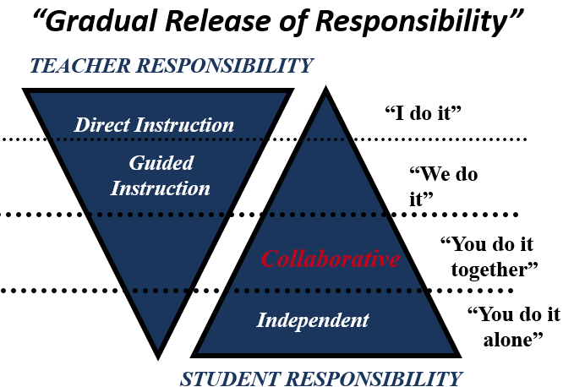
Model a Think Aloud for Planning and Writing
Think Aloud (I do it)
Collaborative planning and writing (We do it)
Group planning and writing (You do it together)
Independent planning and writing (You do it alone)

Slide 46
Model a Think Aloud for Planning and Writing
Model prompt analysis – problem definition
Model writing in mode, using strategy
Refer to strategy steps while writing
Model a planning system to guide the writer
Model positive statements linking strategy use to success
Model self-encouraging statements while writing
Model thinking about goals while writing
Model managing frustration, idea-generation, focus, etc.
Model self-evaluating writing and making revisions as needed

Slide 47
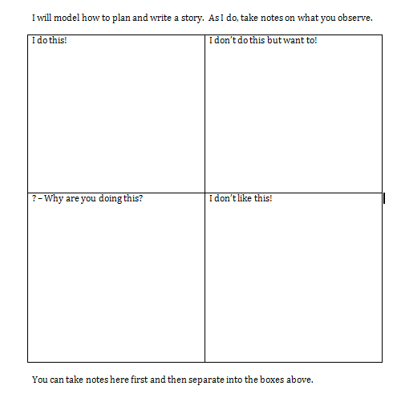
Analyze Modeled Think Aloud
Structured observation notes:

Slide 48
Lead Collaborative Plan/Write and Build Collaborative Partnership
Explain purpose
Write to new prompt/same sources
Model POW, esp. pull apart prompt
Model TIDE(LL) to plan
Model/ask how to cope/encourage
Use graphic organizer to plan
Involve students in plan & write
Release students when ready

Slide 49
Stage 3: Model It
Introduce self-talk
Model a think aloud using self-regulation and writing strategies
Analyze modeled think aloud for strategies and self-regulation
Lead collaborative plan/write
Build collaborative partnership
Introduce scoring
Score samples (option: collaborative writes)
Score with scales (then graph)
Support goal setting

Slide 50
Introduce Scoring
Score a sample paper together as a class (ideally, the collaborative write)
Or, ask for volunteers to have their paper scored by the class

Slide 51
Introduce Scoring
Explain purpose for scoring writing
Explain that scoring helps us know how to improve
Explain scale/criteria needed for points
Explain color coding system
Score essay together, one section at time, color coding as you go
Students show points they would give
Pre-empt frustration when students self-score

Slide 52
Writing Scoring Meeting Protocols

Slide 53
Support Goal Setting

Slide 54
Support Goal Setting

Slide 55
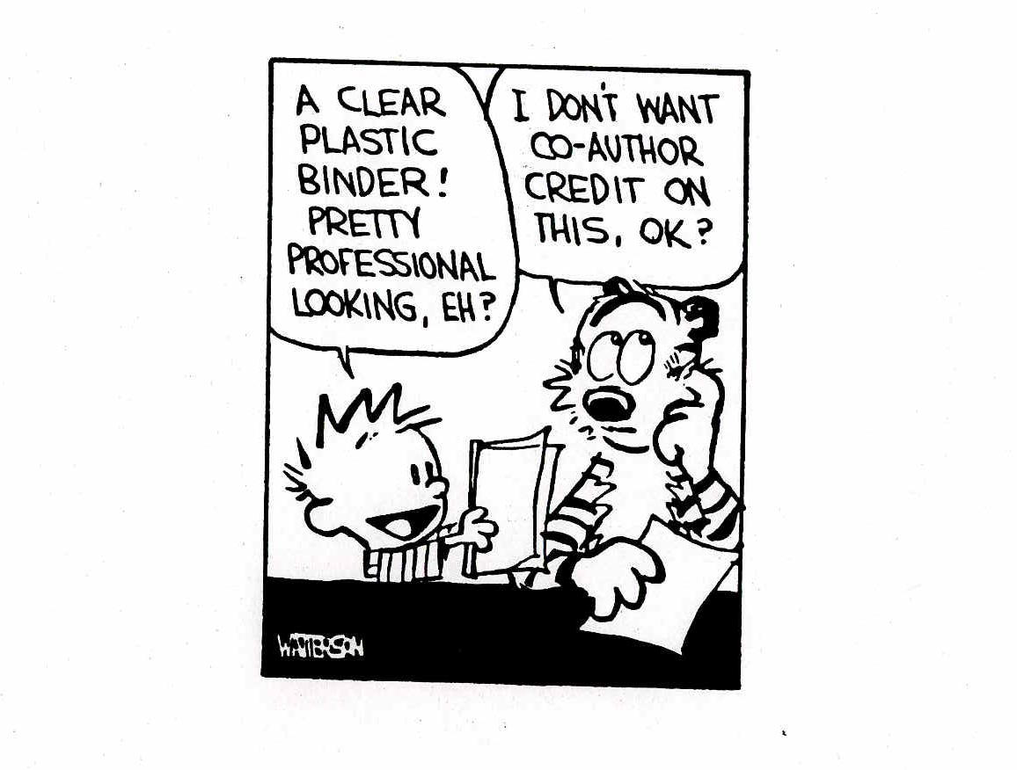
Support Goal Setting

Slide 56
Support Goal Setting
Students who write well have clear, appropriate goals, such as:
“I’ll do a strong topic sentence”
“I’ll weave in more precise vocabulary”
Students who struggle have less clear goals:
“I’ll use a plastic binder”
“I’ll write really big”
“I’ll do good punktuashins”

Slide 57
Stage 4: Memorize It
Daily review of mnemonic and strategies
Can add motions, songs, games, chants, quizzes, etc. to aid memorization
Internalize personalized self-statements

Slide 58
Stage 5: Support It
Students given needed time daily to plan, write, revise, etc.
Scaffold planning and writing with gradual release of control
Fade graphic organizers, word charts, etc.
Regular scoring practice
Introduce new or higher level goals as appropriate
Introduce peer-feedback
Support internalizing strategy use
Provide feedback on writing and self-regulation
Discuss and support transfer
Small group conferring
Differentiate instruction
Notes:
Students plan, write, revise, and publish in this stage

Slide 59
Students Given Needed Time
SRSD won’t make a meaningful difference without Stage 5.
There is no magic in the mnemonics or modeling!
Real improvement requires all 6 stages of instruction be implemented with integrity.
Devote time daily to writing in mode.
Notes:
Scaffold planning and writing: What are the best student examples to show?
Fade graphic organizers

Slide 60
Regular Scoring Practice and Introduce Peer Feedback
Directly teach self- and peer-scoring
Structure feedback
Introduce new or higher-level goals
Notes:
Scaffold planning and writing: What are the best student examples to show?
Fade graphic organizers
Students map different level pieces.

Slide 61
Provide Feedback
Feedback can be used right away
Feedback from self, peer, and adult is ideal
Hunt for treasures, not errors
Keep feedback relevant to specific criteria you have taught/areas of focus (goals)
Separate feedback from grades
Students must believe feedback to be attainable
Ask students how/when they use strategies
Notes:
Small-group conferring
Differentiate instruction
Differentiated practice
Differentiated materials

Slide 62
Notes:
Small-group conferring
Differentiate instruction
Differentiated practice
Differentiated materials

Slide 63
Stage 6: Independent Practice
Use strategies and self-regulate independently
Fade overt self-instruction to covert
Ensure transfer of strategies and self-regulation
Collect final (post) assessment
Notes:
Cycle back again with higher level elements as instructional focus or begin new mode

Slide 64
Use Strategies and Self-regulate Independently
Explain purpose for using self-statements
Explain when to use self-statements
Explain the chart with six types of self-statements or allow students to generate self-statements
Have students generate their own self-statements
Students internalize self-statements and use them regularly

Slide 65
Six Types of Self-statements

Slide 66
Use Strategies and Self-regulate Independently
Notes:
Fade to covert self-instruction

Slide 67
Collect final (post) assessment
Do another cold write
Next steps?
Begin new mode
Continue with higher-level goals

Slide 68
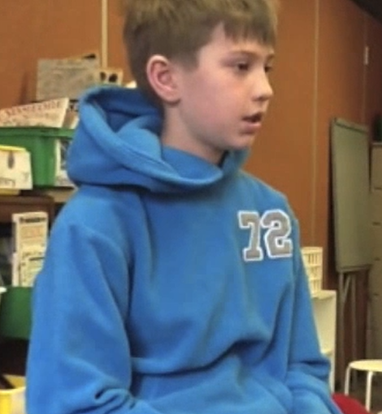
A Student Perspective
“It takes the stress out of writing because you know what to do.” – Logan

Slide 69
Reflection
3
What three things did you learn that will impact your practices as a teacher?
2
What two ideas do you need to discuss with teaching team?
1
What one idea do you need to share with your building leader?

Slide 70
Embedding Language
into Reading

Slide 71
Grammar and Mechanics Research
“Terminology and rules are pointless if your mind hasn’t grasped the concepts behind the terminology” (Keith, 1997).
“[Researchers] contend that a better understanding of how language works in a variety of contexts supports learning in literacy” (Denham and Lobeck, 2005; Hudson, 2004).

Slide 72
Why Teach Grammar and Mechanics?
Grammar and mechanics…
are not rules to be mastered, but tools to serve a writer.
shape meaning as well as allow writer’s words to be understood by the reader.

Slide 73
GRAMMAR
MECHANICS
The principles that guide the structure of sentences and paragraphs.
Syntax: the flow of language
Usage: how we use words in different situations
Rules: predetermined boundaries and patterns that govern language
How we punctuate to achieve meaning.
Punctuation
Capitalization
Paragraphing
Formatting
”Let’s eat Grandma.”
-or-
“Let’s eat, Grandma.”

Slide 74
Grammar vs. Mechanics Activity
Pronoun-antecedent agreement
Quotation marks
Run-on sentences
Prepositional phrases
Use of commas
FANBOYS / sentence combining
Punctuation
Possessives
Double negatives
Dash
Notes:
In partners or with a table group, participants will use sticky notes to sort the activities on the slide into two groups: grammar and mechanics
Grammar: pronoun-antecedent agreement, run-on sentences, FANBOYS, double negatives, and prepositional phrases.
Mechanics: quotation marks, use of commas, punctuation, possessives, and dash.
*Some may fall into BOTH categories* - discuss with participants why this might happen depending on instructional focus.

Slide 75
Check Yourself
GRAMMAR
MECHANICS
pronoun-antecedent agreement
run-on sentences
FANBOYS
double negatives
prepositional phrases
quotation marks
use of commas
punctuation
possessives
dash
Notes:
Ask participants to check their answers with those on the slide.
Ask participants if they have others they would like to share with the group.

Slide 76
Embedded Practice
“Instead of ”drill and kill,” instead of mindless workbook pages, instead of the vapid test preparation materials, I use powerful literature and student writing to teach the rules of language.”
“The ten minutes or so of writer’s workshop I reserve for grammar instruction needs to be filtered through these questions:
How is grammar/mechanics also a craft issue?
How can I use it to generate some authentic text?
How can I look at it in the context of literature?
How can I quickly turn kids back to their writing so they can be on their way to becoming independent revisers, crafters, and editors?”
“All the workshop experts tell us to teach grammar and mechanics in context. Context is about meaning. Any chunk of meaning is context.”
Mechanically Inclined by Jeff Anderson, 2005

Slide 77
Third Grade Language Lesson: Punctuating Dialogue L.3.2c: Use commas and quotation marks in dialogue.

Slide 78
Punctuating Dialogue Lesson Routine
Read the text to the students.
Ask, “What do you notice?”
Highlight the noticing in the text.
Add to the Dialogue Rules! anchor chart.
Practice noticing independently.

Slide 79
Third Grade Language Lesson: Punctuating Dialogue L.3.2c: Use commas and quotation marks in dialogue.
Day 1

Slide 80
And that day, Tillie went to see Mr. Keene. She stood in his office, in
front of his desk.
“What a fine, fine school this is!” Mr. Keene said. “What amazing
things everyone is learning!”
“Yes,” Tillie said, “we certainly are learning some amazing things.”
“A fine, fine school!” Mr. Keene said.
“But,” Tillie said, “not everyone is learning.”
“What?” Mr. Keene said. He looked very worried. “Who? Who isn’t
learning? Tell me, and I will see that they learn!”
page 24
Day 1
Notes:
Day 1: Read the text aloud to the students.
Ask, “What do you notice?” “What do you notice about the punctuation?”

Slide 81
And that day, Tillie went to see Mr. Keene. She stood in his office, in
front of his desk.
“What a fine, fine school this is!” Mr. Keene said. “What amazing
things everyone is learning!”
“Yes,” Tillie said, “we certainly are learning some amazing things.”
“A fine, fine school!” Mr. Keene said.
“But,” Tillie said, “not everyone is learning.”
“What?” Mr. Keene said. He looked very worried. “Who? Who isn’t
learning? Tell me, and I will see that they learn!”
page 24
Day 1
Notes:
After you point out the quotation marks, have the students highlight the quotation marks.
What is the purpose of quotation marks?
.

Slide 82
Dialogue Rules!
Rules
Example
Put quotation marks around what people say aloud.
“A fine, fine school!” Mr. Keene said.
Notes:
Start anchor chart called Dialogue Rules!
Add… Put quotation marks around what people say aloud.

Slide 83
My dog, Beans, hasn’t learned how to sit, Tillie said.
And he hasn’t learned how to jump over the creek.
Oh! Mr. Keene said.
And my little brother hasn’t learned how to swing or
skip, Tillie said.
Oh! Mr. Keene said.
page 25
Day 1
Ind. Practice
Notes:
Students independently practice adding quotation marks only

Slide 84
Third Grade Language Lesson: Punctuating Dialogue L.3.2c: Use commas and quotation marks in dialogue.
Day 2

Slide 85
And that day, Tillie went to see Mr. Keene. She stood in his office, in
front of his desk.
“What a fine, fine school this is!” Mr. Keene said. “What amazing
things everyone is learning!”
“Yes,” Tillie said, “we certainly are learning some amazing things.”
“A fine, fine school!” Mr. Keene said.
“But,” Tillie said, “not everyone is learning.”
“What?” Mr. Keene said. He looked very worried. “Who? Who isn’t
learning? Tell me, and I will see that they learn!”
page 24
Day 2
Notes:
Day 2: Ask, “What else do you notice?”
Highlight and discuss the punctuation. Discuss that it is just a sentence. If it’s a question mark or exclamation mark, it stays, but if it is a period, it turns into a comma.

Slide 86
Dialogue Rules!
Rules
Example
Put end punctuation and commas inside the quotation marks.
“A fine, fine school!” Mr. Keene said.
“But,” Tillie said, “not everyone is learning.”
Notes:
Continue anchor chart called Dialogue Rules!
Add… Put end punctuation and commas inside the quotation marks.

Slide 87
“My dog, Beans, hasn’t learned how to sit ” Tillie said
“And he hasn’t learned how to jump over the creek “
“Oh “ Mr. Keene said
“And my little brother hasn’t learned how to swing or
skip “ Tillie said.
“Oh “ Mr. Keene said.
page 25
Day 2
Ind. Practice
Notes:
Students independently practice adding punctuation only

Slide 88
Third Grade Language Lesson: Punctuating Dialogue L.3.2c: Use commas and quotation marks in dialogue.
Day 3

Slide 89
And that day, Tillie went to see Mr. Keene. She stood in his office, in
front of his desk.
“What a fine, fine school this is!” Mr. Keene said. “What amazing
things everyone is learning!”
“Yes,” Tillie said, “we certainly are learning some amazing things.”
“A fine, fine school!” Mr. Keene said.
“But,” Tillie said, “not everyone is learning.”
“What?” Mr. Keene said. He looked very worried. “Who? Who isn’t
learning? Tell me, and I will see that they learn!”
page 24
Day 3
Notes:
Day 3: Ask, “What else do you notice?”
Highlight and discuss the capitalization.

Slide 90
Dialogue Rules!
Rules
Example
Capitalize the first word of dialogue.
“A fine, fine school!” Mr. Keene said.
Notes:
Continue anchor chart called Dialogue Rules!
Add… Capitalize the first word of dialogue.

Slide 91
“my dog, Beans, hasn’t learned how to sit,” Tillie said.
“and he hasn’t learned how to jump over the creek.”
“oh!” Mr. Keene said.
“and my little brother hasn’t learned how to swing or skip,”
Tillie said.
“oh!” Mr. Keene said.
page 25
Day 3
Ind. Practice
Notes:
Students independently practice adding capitalization

Slide 92
Third Grade Language Lesson: Punctuating Dialogue L.3.2c: Use commas and quotation marks in dialogue.
Day 4

Slide 93
And that day, Tillie went to see Mr. Keene. She stood in his office, in
front of his desk.
“What a fine, fine school this is!” Mr. Keene said. “What amazing
things everyone is learning!”
“Yes,” Tillie said, “we certainly are learning some amazing things.”
“A fine, fine school!” Mr. Keene said.
“But,” Tillie said, “not everyone is learning.”
“What?” Mr. Keene said. He looked very worried. “Who? Who isn’t
learning? Tell me, and I will see that they learn!”
page 24
Day 4
Notes:
Day 4:
Read between the quotation marks.
Ask, “How can you tell when each person is talking?”
Discuss “the saids”, which is called a dialogue tag.
Highlight who is speaking. Discuss how the characters take turns speaking.
Discuss where the dialogue tag is located.

Slide 94
And that day, Tillie went to see Mr. Keene. She stood in his office, in
front of his desk.
“What a fine, fine school this is!” Mr. Keene said. “What amazing
things everyone is learning!”
“Yes,” Tillie said, “we certainly are learning some amazing things.”
“A fine, fine school!” Mr. Keene said.
“But,” Tillie said, “not everyone is learning.”
“What?” Mr. Keene said. He looked very worried. “Who? Who isn’t
learning? Tell me, and I will see that they learn!”
page 24
Day 4
Notes:
Ask, “What is another way you can tell when each character is speaking?”
Discuss spacing which is called indenting.
Read the passage again and check out the theory that a different character is speaking every time it is indented.

Slide 95
Dialogue Rules!
Rules
Example
Indent every time a new person speaks.
“A fine, fine school!” Mr. Keene said.
“But,” Tillie said, “not everyone is learning.”
Notes:
Continue anchor chart called Dialogue Rules!
Add… Indent every time a new person speaks.
Discuss indenting…third grade not held accountable; however, we know from anchor papers, indenting (even if they are experimenting) might bump students from 3 to 4 on writing rubric

Slide 96
“My dog, Beans, hasn’t learned how to sit,” Tillie _______.
“And he hasn’t learned how to jump over the creek.”
“Oh!” Mr. Keene ________.
“And my little brother hasn’t learned how to swing or skip,”
Tillie _________.
“Oh!” Mr. Keene _________.
page 25
Day 4
Ind. Practice
Notes:
Students independently practice adding dialogue tag

Slide 97
Third Grade Language Lesson: Punctuating Dialogue L.3.2c: Use commas and quotation marks in dialogue.
Day 5

Slide 98
and I – she said.
but you go to school Mr. Keene said. to our fine,
fine school
true Tillie said. but I haven’t learned how to
climb very high in my tree. And I haven’t learned how to sit in
my tree for a whole hour
oh Mr. Keene said. Page 25
Day 5
Ind.Practice
Notes:
Students independently practice all rules for quotation marks

Slide 99
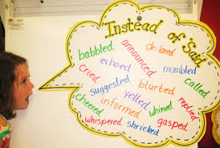
Dialogue Tags
Start an anchor chart of other dialogue tags besides “said” to be gathered across the year.

Slide 100
Punctuating Dialogue L.4.2b: Use commas and quotation marks to mark direct speech and quotations from a text.

Slide 101
Punctuating Dialogue L.4.2b: Use commas and quotation marks to mark direct speech and quotations from a text.
Day 1

Slide 102
I went running up to the front of the library, and there was Miss Franny Block, sitting on the floor behind her desk.
“Miss Franny?” I said. “Are you all right?”
“A bear,” she said.
“A bear?” I asked.
“He has come back,” she said. “He has?” I asked. “Where is he?”
“Out there,” she said and raised a finger and pointed at Winn-Dixie standing up on his hind legs, looking in the window for me.
Page 23
Day 1-4
Notes:
Day 1: Read the text aloud to the students.
Ask, “What do you notice?” “What do you notice about the punctuation?”

Slide 103
I went running up to the front of the library, and there was Miss Franny Block, sitting on the floor behind her desk.
“Miss Franny?” I said. “Are you all right?”
“A bear,” she said.
“A bear?” I asked.
“He has come back,” she said. “He has?” I asked. “Where is he?”
“Out there,” she said and raised a finger and pointed at Winn-Dixie standing up on his hind legs, looking in the window for me.
Page 23
Day 1-4
Notes:
After you point out the quotation marks, have the students highlight the quotation marks.
What is the purpose of quotation marks?

Slide 104
Dialogue Rules!
Rules
Example
Put quotation marks around what people say aloud.
“A fine, fine school!” Mr. Keene said.
Notes:
Start anchor chart called Dialogue Rules!
Add… Put quotation marks around what people say aloud.

Slide 105
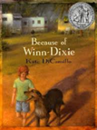
Miss Franny Block, I said, that’s not a bear. That’s a dog. That’s my dog. Winn-Dixie.
Are you positive? she asked.
Yes ma’am, I told her. I’m positive. He’s my dog. I would know him anywhere.
Miss Franny sat there trembling and shaking.
Come on, I said. Let me help you up. It’s okay. I stuck out my hand and Miss Franny took hold of it, and I pulled her up off the floor.
Page 23-24
Day 1
Ind. Practice
Notes:
Students independently practice adding quotation marks only

Slide 106
Punctuating Dialogue L.4.2b: Use commas and quotation marks to mark direct speech and quotations from a text.
Day 2

Slide 107
I went running up to the front of the library, and there was Miss Franny Block, sitting on the floor behind her desk.
“Miss Franny?” I said. “Are you all right?”
“A bear,” she said.
“A bear?” I asked.
“He has come back,” she said. “He has?” I asked. “Where is he?”
“Out there,” she said and raised a finger and pointed at Winn-Dixie standing up on his hind legs, looking in the window for me.
Page 23
Day 1-4
Notes:
Day 2: Ask, “What else do you notice?”
Highlight and discuss the punctuation. Discuss that it is just a sentence. If it’s a question mark or exclamation mark, it stays, but if it is a period, it turns into a comma.

Slide 108
Dialogue Rules!
Rules
Example
Put end punctuation and commas inside the quotation marks.
“A fine, fine school!” Mr. Keene said.
“But,” Tillie said, “not everyone is learning.”
Notes:
Continue anchor chart called Dialogue Rules!
Add… Put end punctuation and commas inside the quotation marks.

Slide 109
“Miss Franny Block “ I said “that’s not a bear That’s a dog. That’s my dog. Winn-Dixie “
“Are you positive “ she asked.
“Yes ma’am “ I told her “I’m positive. He’s my dog. I would know him anywhere “
Miss Franny sat there trembling and shaking.
“Come on “ I said. “Let me help you up. It’s okay “ I stuck out my hand and Miss Franny took hold of it, and I pulled her up off the floor.
Page 23-24
Day 2
Ind. Practice
Notes:
Students independently practice adding punctuation only

Slide 110
Punctuating Dialogue L.4.2b: Use commas and quotation marks to mark direct speech and quotations from a text.
Day 3

Slide 111
I went running up to the front of the library, and there was Miss Franny Block, sitting on the floor behind her desk.
“Miss Franny?” I said. “Are you all right?”
“A bear,” she said.
“A bear?” I asked.
“He has come back,” she said. “He has?” I asked. “Where is he?”
“Out there,” she said and raised a finger and pointed at Winn-Dixie standing up on his hind legs, looking in the window for me.
Page 23
Day 1-4
Notes:
Day 3: Ask, “What else do you notice?”
Highlight and discuss the capitalization.

Slide 112
Dialogue Rules!
Rules
Example
Capitalize the first word of dialogue.
“A fine, fine school!” Mr. Keene said.
Notes:
Continue anchor chart called Dialogue Rules!
Add… Capitalize the first word of dialogue.

Slide 113
“miss Franny Block,” I said, “that’s not a bear.” That’s a dog. That’s my dog. Winn-Dixie.”
“are you positive?” she asked.
“yes ma’am,” I told her. “i’m positive. He’s my dog. I would know him anywhere.”
Miss Franny sat there trembling and shaking.
“come on,” I said. “let me help you up. It’s okay.” I stuck out my hand and Miss Franny took hold of it, and I pulled her up off the floor.
Page 23-24
Day 3
Ind. Practice
Notes:
Students independently practice adding capitalization.

Slide 114
Punctuating Dialogue L.4.2b: Use commas and quotation marks to mark direct speech and quotations from a text.
Day 4

Slide 115
I went running up to the front of the library, and there was Miss Franny Block, sitting on the floor behind her desk.
“Miss Franny?” I said. “Are you all right?”
“A bear,” she said.
“A bear?” I asked.
“He has come back,” she said. “He has?” I asked. “Where is he?”
“Out there,” she said and raised a finger and pointed at Winn-Dixie standing up on his hind legs, looking in the window for me.
Page 23
Day 1-4
Notes:
Day 4:
Read between the quotation marks.
Ask, “How can you tell when each person is talking?”
Discuss “the saids”, which is called a dialogue tag.
Highlight who is speaking. Discuss how the characters take turns speaking.
Discuss where the dialogue tag is located.

Slide 116
I went running up to the front of the library, and there was Miss Franny Block, sitting on the floor behind her desk.
“Miss Franny?” I said. “Are you all right?”
“A bear,” she said.
“A bear?” I asked.
“He has come back,” she said. “He has?” I asked. “Where is he?”
“Out there,” she said and raised a finger and pointed at Winn-Dixie standing up on his hind legs, looking in the window for me.
Page 23
Day 1-4
Notes:
Ask, “What is another way you can tell when each character is speaking?”
Discuss spacing which is called indenting.
Read the passage again and check out the theory that a different character is speaking every time it is indented.

Slide 117
Dialogue Rules!
Rules
Example
Indent every time a new person speaks.
“A fine, fine school!” Mr. Keene said.
“But,” Tillie said, “not everyone is learning.”
Notes:
Continue anchor chart called Dialogue Rules!
Add… Indent every time a new person speaks.
Discuss indenting…third grade not held accountable; however, we know from anchor papers, indenting (even if they are experimenting) might bump students from 3 to 4 on writing rubric

Slide 118
“Miss Franny Block,” I __________, “that’s not a bear.” That’s a dog. That’s my dog. Winn-Dixie.”
“Are you positive?” she ____________.
“Yes ma’am,” I ________ her. “I’m positive. He’s my dog. I would know him anywhere.”
Miss Franny sat there trembling and shaking.
“Come on,” I ___________. “Let me help you up. It’s okay.” I stuck out my hand and Miss Franny took hold of it, and I pulled her up off the floor.
Pages 23-24
Day 4
Ind. Practice
Notes:
Students independently practice adding dialogue tag

Slide 119
Punctuating Dialogue L.4.2b: Use commas and quotation marks to mark direct speech and quotations from a text.
Day 5

Slide 120
well no, look at that she said that dog is smiling at me
it’s a talent of his I told her
it is a fine talent Miss Franny said a very fine talent And she smiled back at Winn-Dixie
we could be friends I said to Miss Franny I mean you and me and Winn-Dixie, we could all be friends
Miss Franny smiled even bigger. Why, that would be grand she said just grand
Day 5
Ind. Practice
Notes:
Students independently practice all rules for quotation marks

Slide 121
Dialogue Tags
Start an anchor chart of other dialogue tags besides “said” to be gathered across the year.

Slide 122
Embedded Language Activity
As a group…
choose a week from the ELA Instructional Pacing Guide
plan an embedded language lesson
incorporate part of the shared reading text in the lesson

Slide 123
Third Grade
Week | Shared Reading Text | Language Standard
1 | N/A | L.3.1a: Nouns, verbs L.3.1i: Simple sentences L.3.3b: Spoken and written English
3 | The Trial of Cardigan Jones | L.3.1b: Irregular Plural Nouns L.3.1c: Abstract Nouns
4 | Pop’s Bridge | L.3.2d: Possessives
5 | Roberto Clemente | L.3.1e: Simple verb tenses L.3.1f: Subject-verb/pronoun-antecedent agreement
6 | Amos and Boris | L.3.1h: Coordinating conjunctions L.3.1i: Compound sentences
7 | “My Mom Hates to Cook” | L.3.1h: Coordinating conjunctions L.3.1i: Compound sentences
8 | Oceans TNCore Unit | L.3.5b: Real-life connections L.3.5c: Shades of meaning
9 | What Do Illustrators Do? | L.3.2g: Reference materials

Slide 124
Fourth Grade
Week | Shared Reading Text | Language Standard
1 | N/A | Review L.3.1a: Nouns and Pronouns L.4.1f: Complete sentences, fragments, run-ons L.4.2a: Capitalization
3 and 4 | Stormalong | L.4.1b: Verb Tenses Review L.3.1a: Verbs Review L.3.1a: Adverbs
5 | Dear Mr. Winston | Review L.3.1a: Adjectives L.4.1d: Order adjectives
6 | My Librarian is a Camel | L.4.2c: Commas before conjunctions L.4.4c: Reference materials L.4.5c: Antonyms and Synonyms
7 | TNCore Writing Task
8 | Hurricanes | L.4.1g: Frequency confused words L.4.3c: Formal and informal English

Slide 125
Share Language Lessons

Slide 126
In Conclusion…
“The teaching of grammar should be part of a program that is rich in reading and writing. Writing and reading the works of other writers provide a rich context for the study of language. Without that context, isolated study of grammar and usage is a detached and futile exercise. It is within the context of our own words and the words of authors we love that caring about grammar can happen.”
Getting Grammar: 150 New Ways to Teach an Old Subject, 2006
.

Slide 127
Use literature and student writing to teach the rules of language.
Focus on the craft of writing instead of correctness.
Allow students to be active problem solvers.
Teach one thing at a time and apply to daily writing expectations.
Use quick daily doses of grammar and mechanics with short mentor texts.

Slide 129
Analyzing Writing Samples

Slide 130
Analyzing Student Writing

Slide 131
Analyzing Student Writing

Slide 132
Analyzing Student Writing

Slide 133
Informative Writing Rubric

Slide 134
Wrap Up

Slide 135
Resources
The Learning Center: Updated literacy resources
Professional literacy books

Slide 136
Thank you!
boonel@jcschools.org
dotsonj@jcschools.org
hogant@jcschools.org

